Slide 1

Macroeconomics
Sixth Canadian Edition
Chapter 2
Measurement
Copyright © 2021 Pearson Canada Inc.
Notes:
If this PowerPoint presentation contains mathematical equations, you may need to check that your computer has the following installed:
1) MathType Plugin
2) Math Player (free versions available)
3) NVDA Reader (free versions available)

Slide 2
Chapter 2 Topics
Measuring GDP
Nominal and real GDP and price indices
Savings, wealth and capital
Labour market measurement

Slide 3
Measuring GDP: The National Income and Product Accounts (NIPA)
GDP Measured Using: (i) the product approach; (ii) the expenditure approach; (iii) the income approach.
Show how this is done using an example.

Slide 4
National Income Accounting Example
Fictional Island Economy
Coconut Producer, Restaurant, Consumers, Government

Slide 5
Table 2.1 Coconut Producer
Total revenue | $20 million
Wages | $ 5 million
Interest on loan | $ 0.5 million
Taxes | $ 1.5 million

Slide 6
Table 2.2 Restaurant
Total revenue | $30 million
Cost of coconuts | $12 million
Wages | $ 4 million
Taxes | $ 3 million

Slide 7
Table 2.3 After-Tax Profits
Coconut producer | $13 million
Restaurant | $11 million

Slide 8
Table 2.4 Government
Tax revenue | $5.5 million
Wages | $5.5 million

Slide 9
Table 2.5 Consumers
Wage income | $14.5 million
Interest income | $ 0.5 million
Taxes | $ 1 million
Profits distributed by producers | $24 million

Slide 10
Table 2.6 GDP Using the Product Approach
Value added—coconuts | $20 million
Value added—restaurant | $18 million
Value added—government | $ 5.5 million
GDP | $43.5 million

Slide 11
Table 2.7 GDP Using the Expenditure Approach
Consumption | $38 million
Investment | 0
Government expenditures | $ 5.5 million
Net exports | 0
GDP | $43.5 million

Slide 12
Table 2.8 GDP Using the Income Approach
Wage income | $14.5 million
After-tax profits | $24 million
Interest income | $ 0.5 million
Taxes | $ 4.5 million
GDP | $43.5 million

Slide 13
Table 2.9 Gross Domestic Product for 2017 (1 of 2)
Component of GDP | $ Billions | % of GDP*
GDP | 2137.5 | 100
Consumption | 1241.0 | 58.1
Durables | 161.4 | 7.6
Semi-durables | 84.4 | 3.9
Nondurables | 284.3 | 13.3
Services | 678.3 | 31.7
Investment | 405.9 | 19.0
Nonresidential | 202.4 | 9.5
Residential | 164.7 | 7.7
Change in inventories | 17.5 | 0.8
Intellectual property prods. | 35.6 | 1.7

Slide 14
Table 2.9 Gross Domestic Product for 2018 (2 of 2)
Government expenditures | 523.7 | 24.5
Government consumption | 442.8 | 20.7
Government investment | 80.9 | 3.8
Net exports | −50.4 | -2.4
Exports | 663.7 | 31.1
Imports | −714.1 | −33.4
*Percentages do not add up to 100 because of rounding and statistical discrepancy. Source: Statistics Canada database, Table 384-0038. © Stephen D. Williamson.

Slide 15
Problems in Measuring GDP
Economic activity in the underground economy cannot be measured directly – this activity might be measured indirectly by accounting for the use of currency.
Government production is difficult to measure, as the output (for example defense services) is typically not sold in the market.

Slide 16
Nominal and Real GDP and Price Indices
Price Index: Weighted average of a set of observed prices that gives a measure of the price level.
Price indices allow us to measure the inflation rate – the rate of change in the price level.
A measure of the inflation rate allows us to determine how much of an increase in GDP is nominal and how much is real.

Slide 17
Table 2.10 Data for Real GDP Example
 | Apples | Oranges
Quantity in year 1 | 50 | 100
Price in year 1 | $1 | $0.80
Quantity in year 2 | 80 | 120
Price in year 2 | $1.25 | $1.60

Slide 18
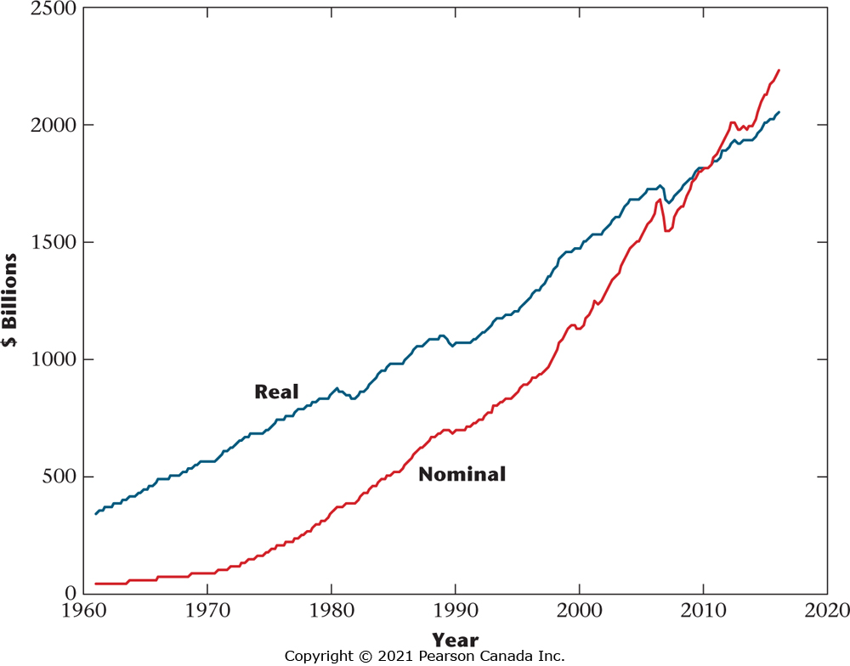
Figure 2.1 Nominal GDP (red line) and Chain-Weighted Real GDP (blue line), 1961–2018
Note that the two time series cross in 2012 because real GDP is measured in 2012 dollars. The growth
rate in real GDP is smaller than the growth rate for nominal GDP because of positive inflation over this
period.

Slide 19
Table 2.11 Implicit GDP Price Deflators, Example
 | Year 1 | Year 2 | % Increase
Year 1 = base year | 100 | 165.9 | 65.9
Year 2 = base year | 58.4 | 100 | 71.2
Chain-weighting | 100 | 168.5 | 68.5

Slide 20
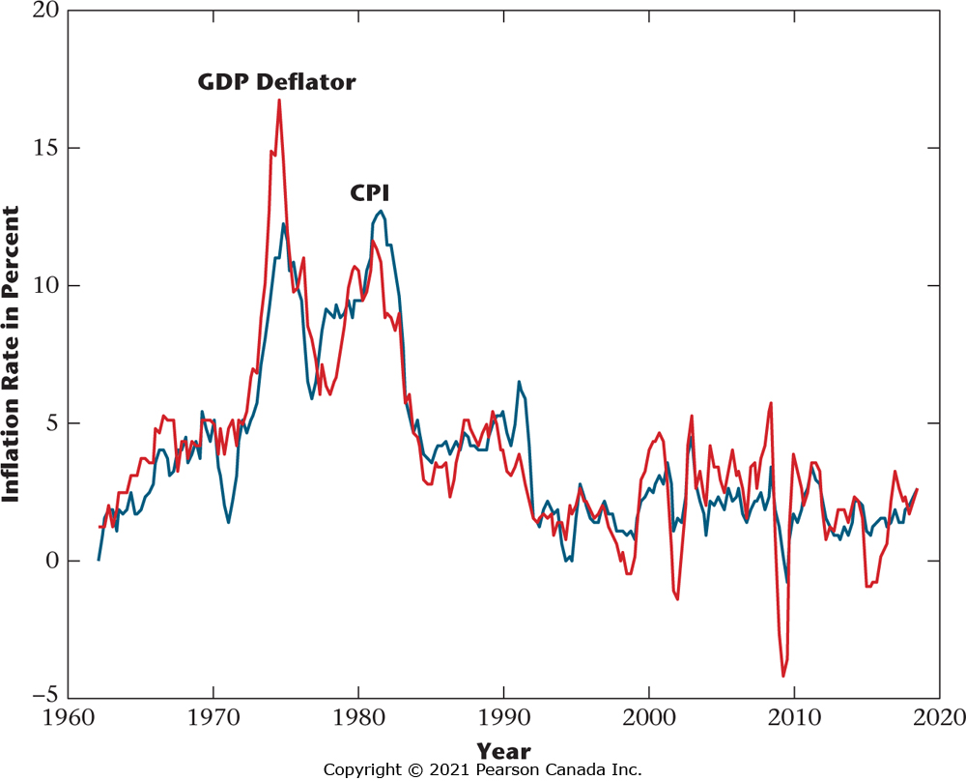
Figure 2.2 Quarterly Inflation Rate Calculated from the CPI (blue line) and the Implicit GDP Price Deflator (red line), 1962–2018
These measures are broadly similar, but there can be substantial differences.

Slide 21
Problems in Measuring Real GDP and the Price Level
The relative prices of goods change over time – a problem for CPI measurement.
The quality of goods and services changes over time.
New goods and services are introduced, and some goods and services become obsolete.

Slide 22
Savings, Wealth and Capital (1 of 5)
Private Disposable Income:

Slide 23
Savings, Wealth and Capital (2 of 5)
Private Sector Saving:

Slide 24
Savings, Wealth and Capital (3 of 5)
Government Saving = − Government Deficit:

Slide 25
Savings, Wealth and Capital (4 of 5)
National Saving = Private Saving + Government Saving:

Slide 26
Savings, Wealth and Capital (5 of 5)
National savings is reflected in investment (new capital stock) plus the current account surplus (acquisition of claims on foreigners):

Slide 27
Labour Market Measurement
The Statistics Canada monthly household survey divides the working-age population into three groups:
Employed
Unemployed
Not in the Labour Force
Labour force = employed + unemployed

Slide 28
Three Key Labour Market Measures

